Slide 1
California Public Records Act and freedom of information act
A PRIMER FOR UCR ADMINISTRATORS
AUGUST 24, 2015

Slide 2
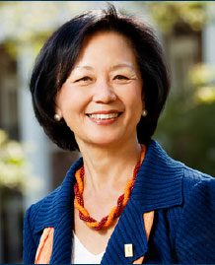
University of Illinois, Urbana - Champaign
Chancellor Wise (re Salaita):
“[Advisor] warned me and others not to use email since we are now in a litigation phase. We are doing virtually nothing over our Illinois email addresses. I am even careful with this email address and deleting after sending.”
“Let me add that the hateful, totally unprofessional and unacceptable Twitters have appeared mainly since July. This is after the decision to hire him and after his acceptance of our offer.”

Slide 3
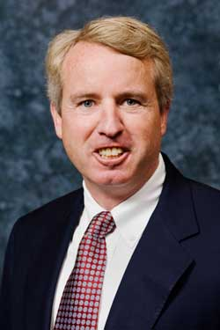
University of Illinois, Urbana - Champaign
Trustee Chair Kennedy (re Kilgore):
“[The University] needs to, in many ways, reflect the values of the state."
“I think they are going to be offended by the notion that their taxes are going to support the lifestyle and career of a fellow who tried to overthrow the U.S. government and targeted police officers and innocent victims for killings,”…“the second chance should not come from public support.”

Slide 4
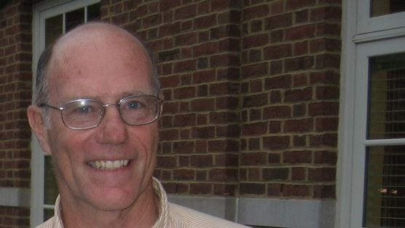
University of Illinois, Urbana - Champaign
“Given that we have held up to the students as examples people like this fellow, who thought it was OK to target cops and noncombatants for murders as an expression for political disagreement.”
“If we become too cavalier in our attitudes about this, then the people of the state and their representatives will respond. They'll hinder our ability to free ourselves of unwanted procurement rules, they'll limit our ability to provide supplemental retirement benefits, they'll acquiesce to a decrease in … support for the university.”

Slide 5
California public Records Act
Two Competing Interests: Access to Public Records and Privacy
“The Legislature, mindful of the right of individuals to privacy, finds and declares that access to information concerning the conduct of the people’s business is a fundamental and necessary right of every person in this state.” (California Government Code section 6250; see also California Constitution, Article I, Section 3(b))
The Legislative intent says that: “access to information concerning the conduct of the people’s business is a fundamental and necessary right of every person in this state.”

Slide 6
California public Records Act
Presumption favoring disclosure of public record: If a record is a “public record” as defined, then there is a presumption that the public has a right of access to that record.
Statutory exemptions allowing for non-disclosure must be read narrowly.

Slide 7
WHAT IS A “PUBLIC RECORD”?
Public Record: includes “Any writing containing information relating to the conduct of the public’s business prepared, owned, used, or retained” by the University, “regardless of physical form or characteristics.”
Note: This includes not just the records that we create, but any record in our possession.

Slide 8
What is a Writing?
Writing: includes “any handwriting, typewriting, printing, photostating, photographing, photocopying, transmitting by electronic mail or facsimile, and every other means of recording upon any tangible thing any form of communication or representation, including letters, words, pictures, sounds, or symbols, or combinations thereof, and any record thereby created, regardless of the manner in which the record has been stored.”
Note: This is a broad definition that includes any form in which information can be retained. This includes handwritten notes, e-mail, and information contained in databases.

Slide 9
KEY EXEMPTIONS
Preliminary drafts, notes, or memoranda not retained in ordinary course of business. Retained drafts are subject to disclosure.
Records relating to “pending litigation”.
Personnel, medical, or similar files where the disclosure would constitute an “unwarranted invasion of privacy.”
Police files, including investigatory or security files compiled by any state or local police agency.
Real estate appraisals may be withheld until the property is acquired.
Evidence Code privileges (attorney-client/attorney work product privileges, Official Information, “trade secrets”)
Any other state or federal law protecting records (HIPAA, FERPA, IPA, etc.)

Slide 10
CATCHALL or “Balancing Test” Exemption:
“Public Interest in Non-Disclosure”
Test: “On the facts of the particular case, the public interest served by not making the record public clearly outweighs the public interest served by disclosure of the record.”
Includes the “Deliberative Process” privilege, to protect candid internal pre-decisional deliberations (Governor’s calendar; police chief finalists, etc…)
Includes “burdensomeness.” A request might be so burdensome, and the public interest in the material so small, that the balancing test might allow us to deny the request.
Includes protections for “mid-stream” thinking and research by faculty
EXTREMELY DISFAVORED

Slide 11
The Humane Society of the United States v. The Superior Court of Yolo County
HS sought records relating to the funding, preparation, and publishing of a UC Davis research study were exempt from disclosure under the PRA.
After an in camera review of the documents, the trial court found that none of the records showed that the egg or poultry industries had improperly influenced the study.
Court emphasized that disclosing scholarly research communications would have a chilling effect on the candid and objective analysis of controversial social issues in the academic setting—and that such analysis benefits the public.
Release of documents would harm ability of University to carry out its mission, which depends on the cooperation of community advisors, research collaborators, and farms who provide highly confidential financial data.

Slide 12
PRIVATE EMAILS/TEXTS - City of San Jose v. Superior Court (Smith)
Texts and emails after meeting to discuss proposal to award millions of dollars in contracts for downtown San Jose redevelopment projects.
City argued they were not “public records” for the purposes of the PRA—that is, records “prepared, owned, used, or retained” by a public agency—because they were neither stored on the City’s computers nor accessible to the City.
The holding (under review by California Supreme Court) - Communications sent or received by city officials or staff on Personal Digital Assistant (PDA) devices—including text messages, emails and voicemails on employees’ personal accounts—are not exempt from PRA disclosure if they concern city business.
The Court further stated that it would be “absurd” if a public agency could shield information from public disclosure simply by storing it on equipment it does not technically own.

Slide 13
Attorney Client COMMUNICATION/work product privileges
Not every email copied to an attorney or every note taken with an attorney in the room constitutes a protected communication
Must be sent for purposes of seeking or providing legal advice or for imparting information to facilitate that advice
Includes a legal opinion formed and the advice given by the lawyer (the work product)
No distinction would be made between “inside” and “outside” counsel for the purposes of and application of the privileges
Take clues from responses of Campus Counsel/OGC/Outside Counsel

Slide 14
QUESTIONS?

Slide 15
Final thought
Don’t put it in an email if you don’t want to explain what you meant to a judge

