Slide 1
THE FIRST AMENDMENT RIGHTS OF STUDENTS AND THIRD PARTY SPEAKERS: WHAT CAN A PUBLIC UNIVERSITY DO AND WHERE CAN THEY DO IT?

Slide 2
Agenda
Quick Primer On First Amendment and California Free Speech law and rights of students and others to speak on campus
Application of those rights to particular fora on campus
Heckler’s Veto Doctrine
Current Climate
Prior and Current Legislative attempts in California and possible reactions/pro-active approaches

Slide 3
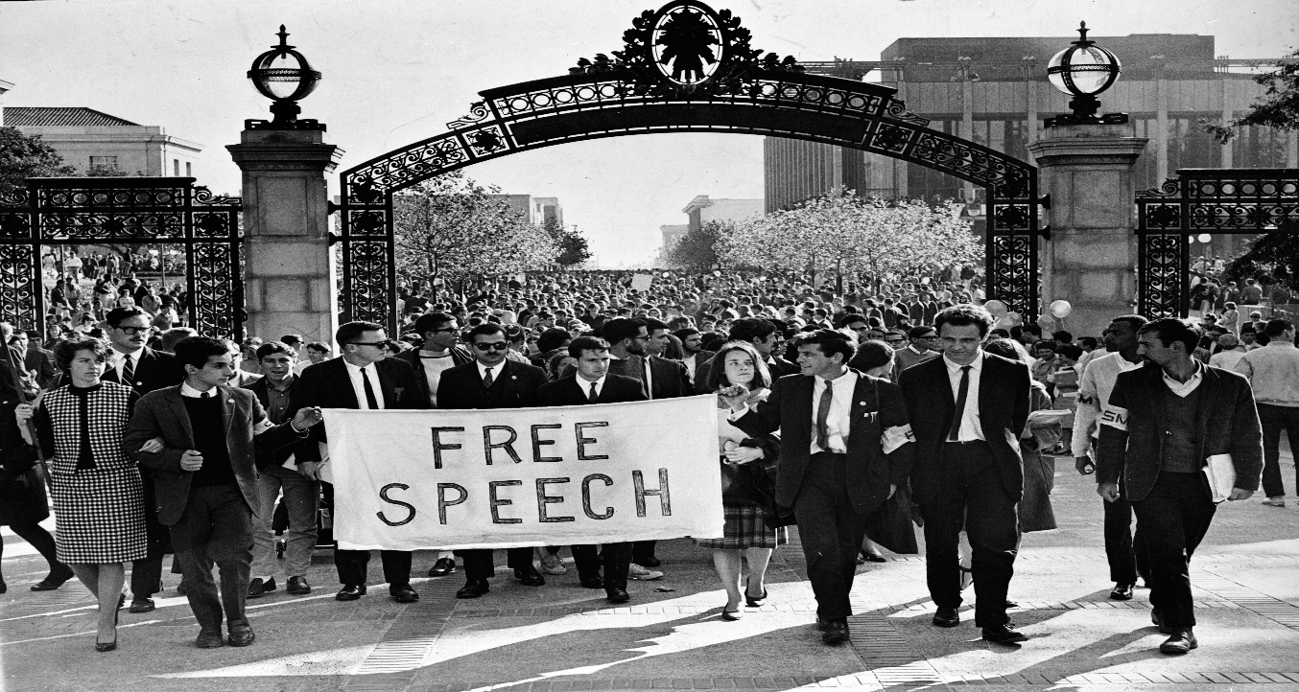
The First Amendment to the United States Constitution
“Congress shall make no law … abridging the freedom of speech … or the right of the people peaceably to assemble...”

Slide 4
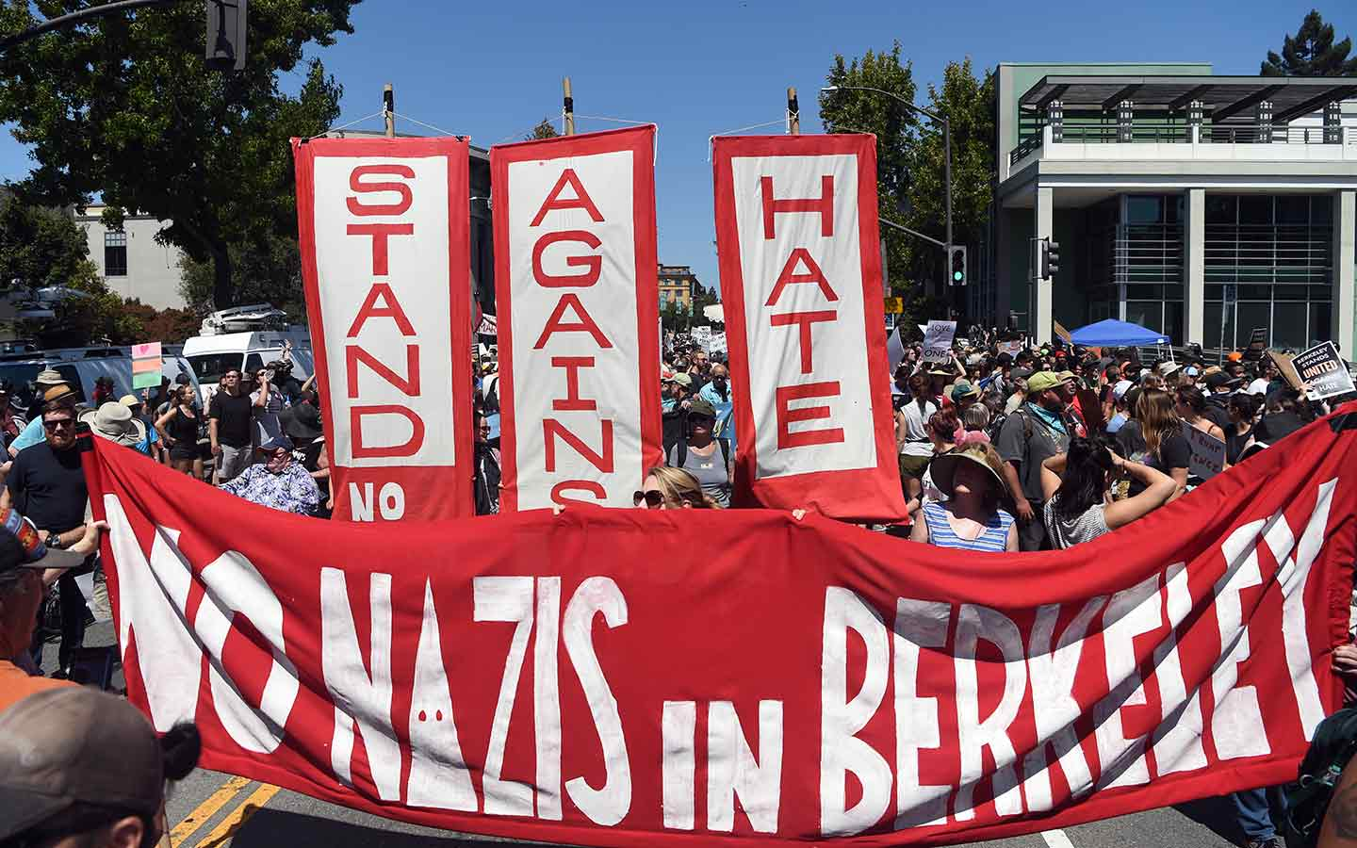
The California Constitution
“[e]very person may freely speak, write and publish his or her sentiments on all subjects, being responsible for the abuse of this right. A law may not restrain or abridge liberty of speech or press…”

Slide 5
UC Policy on Free Speech and Assembly
“The University is committed to assuring that all persons may exercise the constitutionally protected rights of free expression, speech, assembly and worship. It is the responsibility of the Chancellor to assure an ongoing opportunity for the expression of a variety of viewpoints.”
All ten campuses have adopted their own similar local policies and other values-based policies such as Principles of Community

Slide 6
Article IX Section 9 of California Constitution
(a) The University of California shall constitute a public trust, to be administered by the existing corporation known as "The Regents of the University of California," with full powers of organization and government, subject only to such legislative control as may be necessary to insure the security of its funds and compliance with the terms of the endowments of the university and such competitive bidding procedures as may be made applicable to the university by statute for the letting of construction contracts, sales of real property, and purchasing of materials, goods, and services.
-POLICE POWER

Slide 7
PROTECTED “SPEECH?”
broad array of expressive conduct -- oral, written, pictorial and other expressive means that convey an idea.
“Symbolic speech,” such as burning the flag at a protest rally, is also protected, so long as it is not intertwined with additional factors such as disruptive conduct, which is not protected
4 Types:
political*
Religious*
corporate
commercial

Slide 8
Non-Protected “Speech?”
• Promoting actual violence or harm*
• “Fighting words”
• True threats
• Expression that constitutes criminal or severe harassment*
• Defamation
• Obscenity
• False advertising
• Use of public resources for partisan political activities

Slide 9
Restrictions on Speech in a University setting
Depends on the forum

Slide 11
The California Compatibility Test
Whether use of a particular facility for speech activity would interfere with its primary use
If not, then it is “available” for public use.
Broader than US First Amendment Test

Slide 16
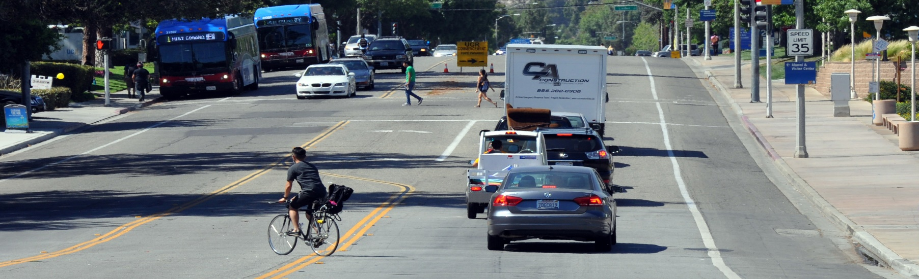
No!

Slide 17
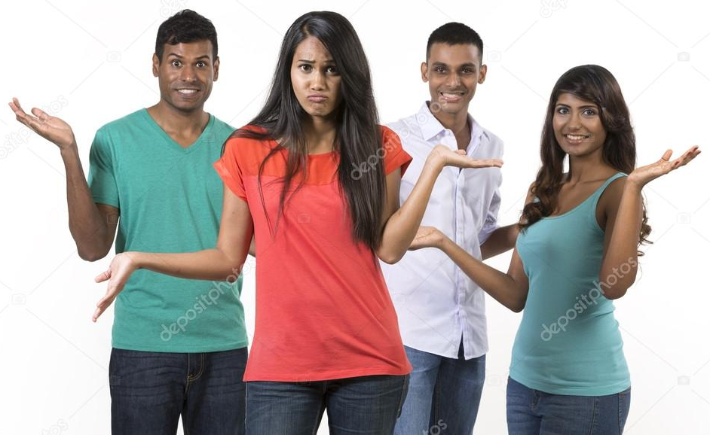

Slide 18
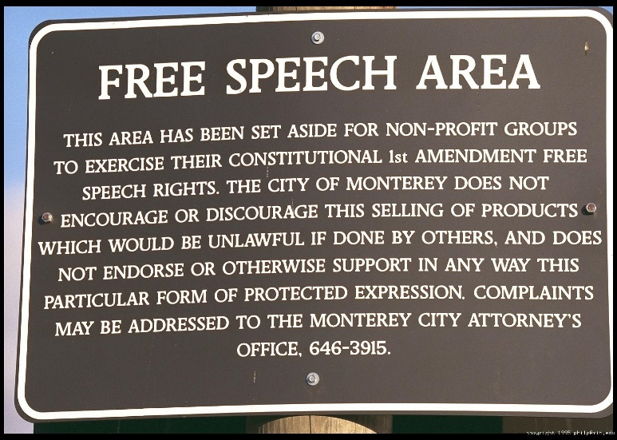

Slide 19
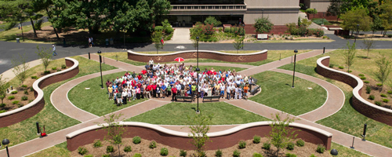

Slide 20
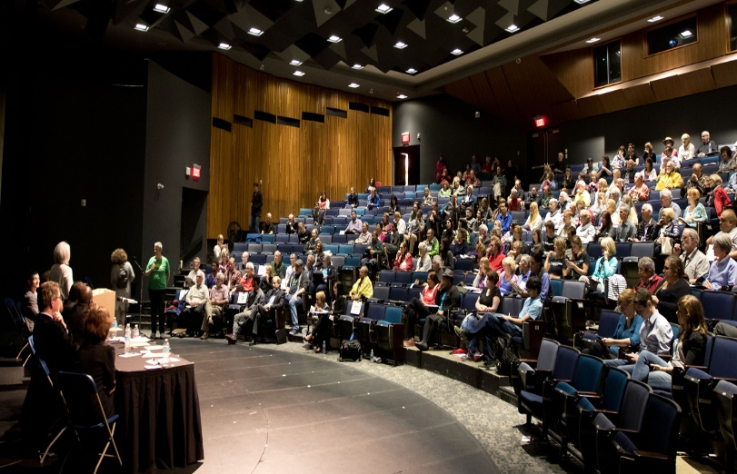

Slide 23
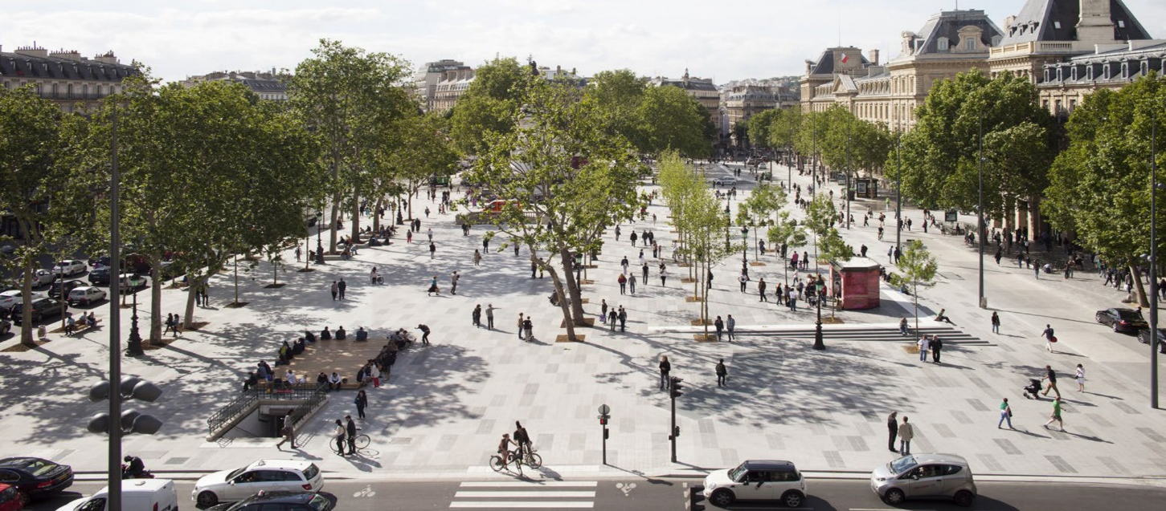

Slide 25
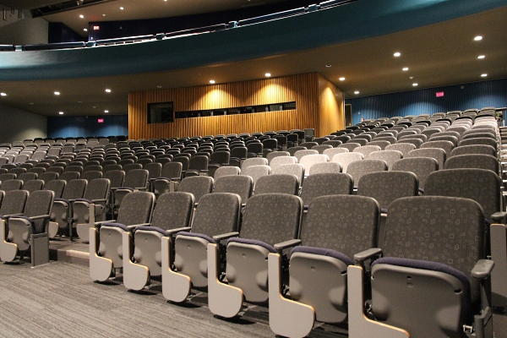
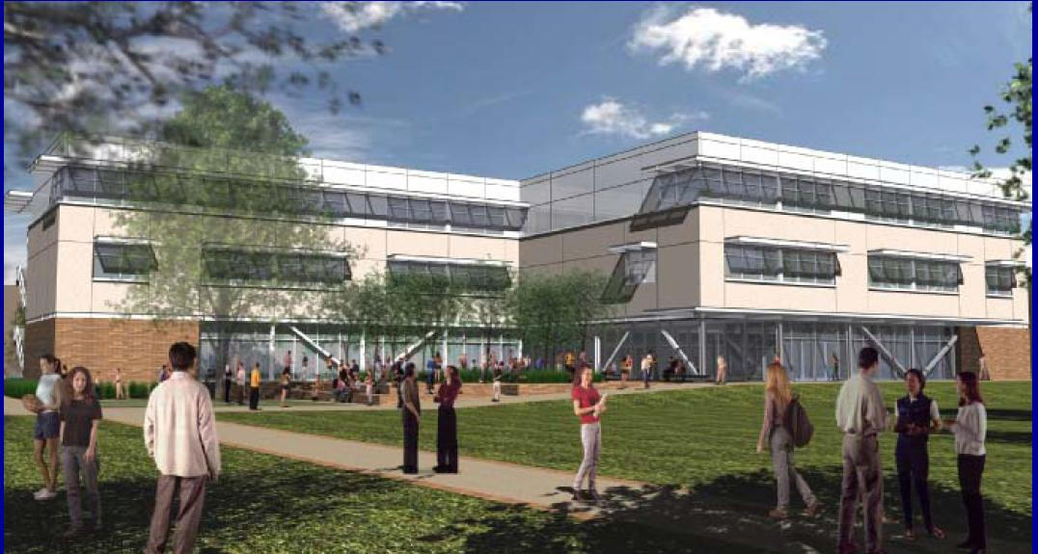
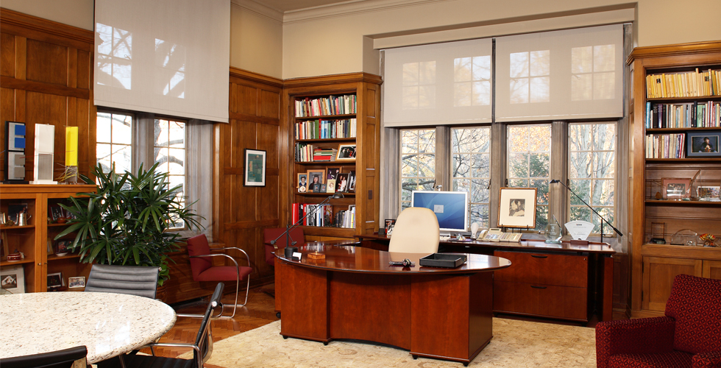

Slide 26
Then what?

Slide 28
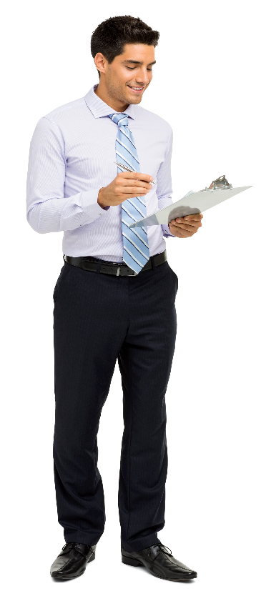

Slide 30
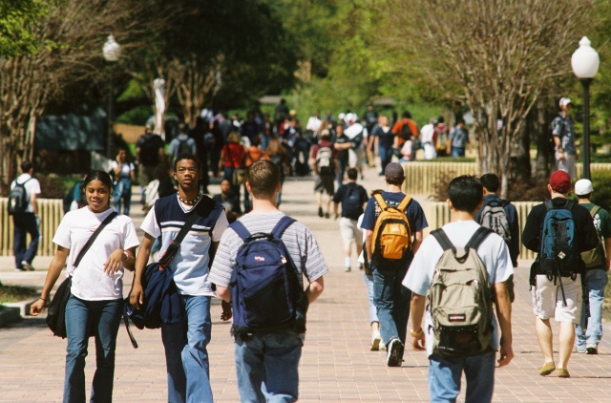
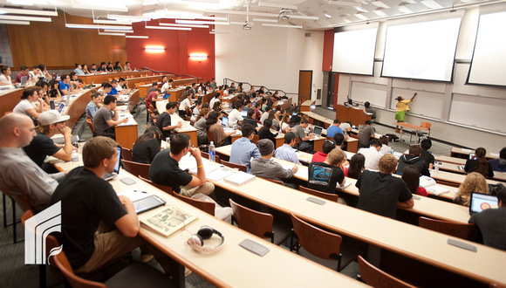
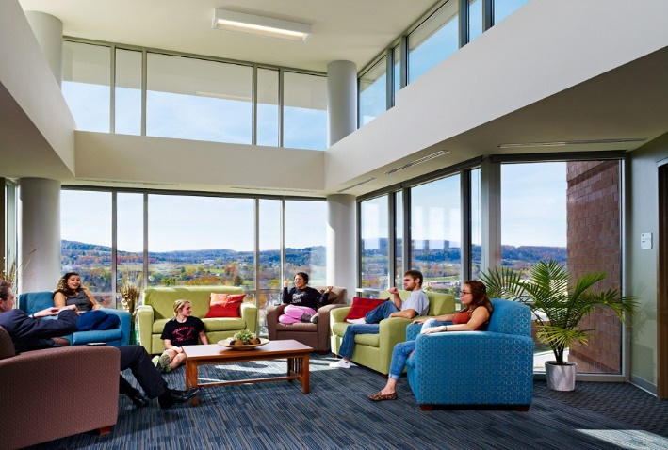

Slide 31
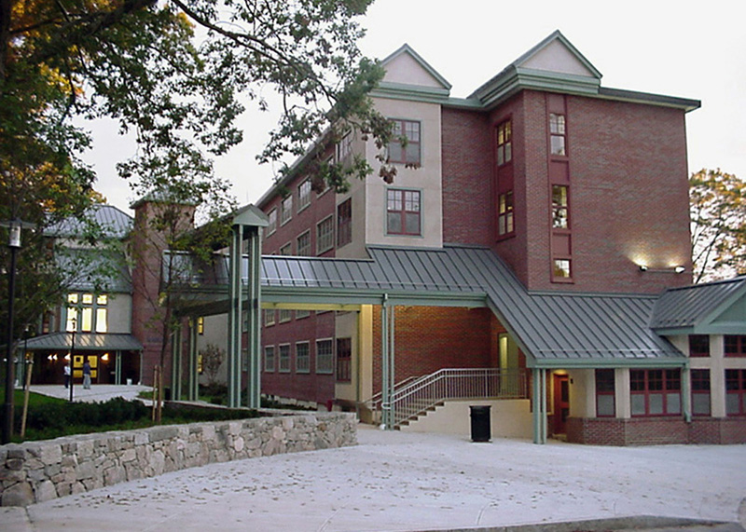

Slide 32
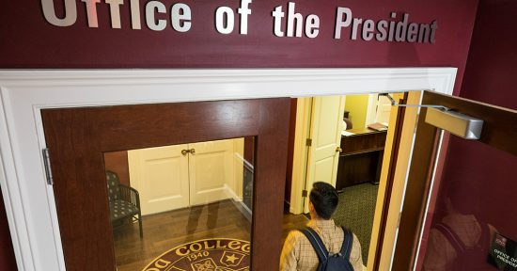

Slide 33
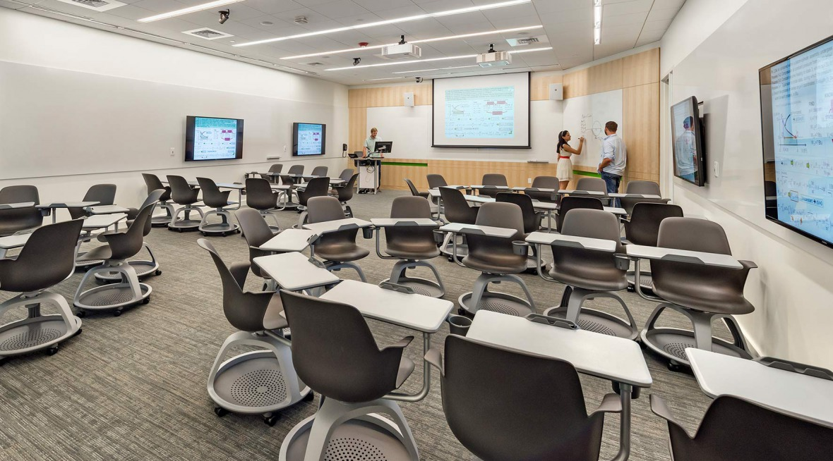

Slide 34
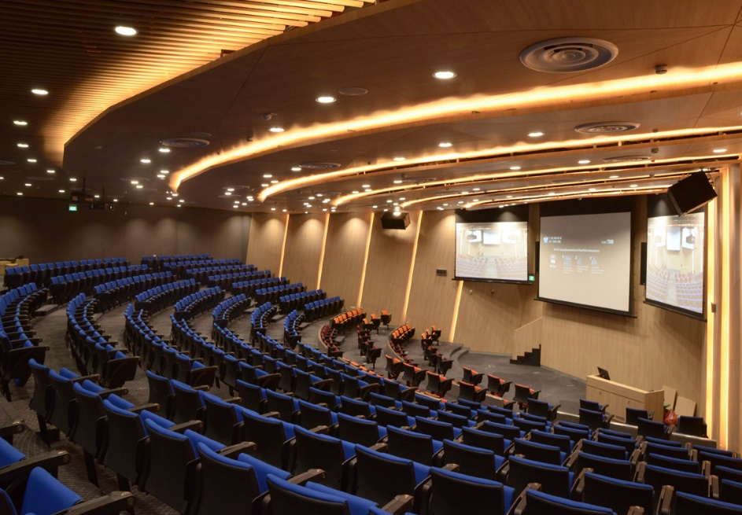

Slide 35
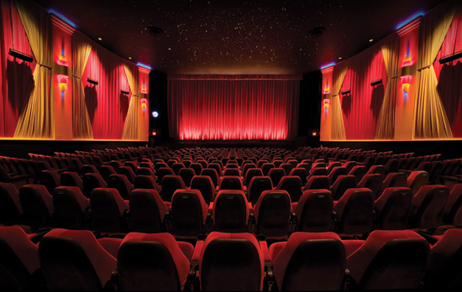

Slide 36
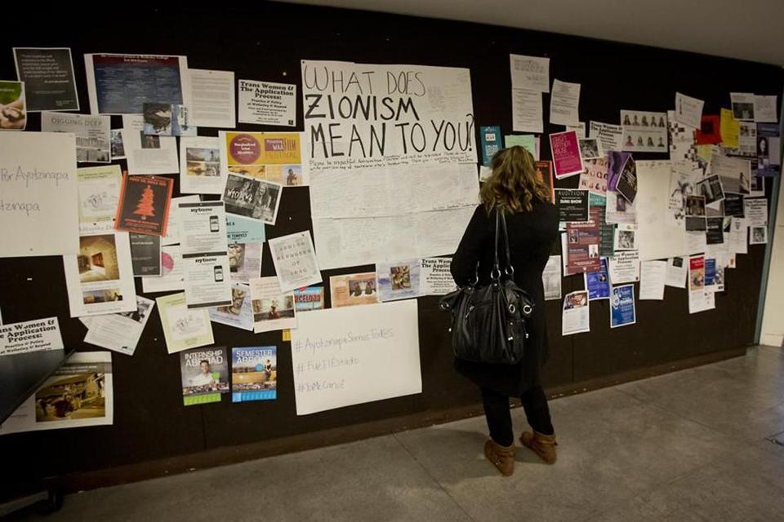

Slide 41
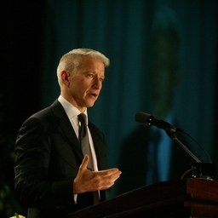

Slide 46
EXAMPLES OF ACCEPTED AND REJECTED METHODS FOR RESTRICTIONS ON SPEECH
Courts categorize different governmental restrictions on speech into three types: (1) content-based restrictions; (2) viewpoint-based restrictions; and (3) time/place/manner restrictions.
Content-based restrictions attempt to regulate the content of speech and are typically subject to strict scrutiny.
Viewpoint-based restrictions limit the expression of certain viewpoints and are almost never held to be constitutional.
Time/place/manner restrictions (sometimes referred to as “content-neutral restrictions”) do not look to the content of the speech but instead attempt to limit the time, place, or manner of the speech, as discussed in the examples above.

Slide 48
Heckler’s Veto
term was coined by University of Chicago professor of law Harry Kalven
speaker's right is curtailed or restricted by the government in order to prevent a reacting party's behavior
arresting demonstrators as a consequence of unruly behavior of by-standers would amount to a heckler's veto
Erwin Chemerinsky (discussing Israeli Ambassador Michael Oren speech): broad freedom exists to invite speakers and hold demonstrations, but that once a speaker has begun an invited lecture, “You have the right—if you disagree with me—to go outside and perform your protest. But you don’t get the right to come in when I’m talking and shout me down. Otherwise people can always silence a speaker by heckler’s veto, and Babel results”

Slide 49
Heckler’s Veto Jurisprudence
In Forsyth County v. Nationalist Movement (1992), the Supreme Court held that the First Amendment protects “[t]hose wishing to express views unpopular with bottle throwers . . . Speech cannot be financially burdened, any more than it can be punished or banned, simply because it might offend a hostile mob.”
This principle was applied to a student in Jones v. Board of Regents (1970), where the United States Court of Appeals for the Ninth Circuit struck down a university handbill ban after a student was removed from campus when threatened with violence for passing out anti-war handbills. The court stated the public university’s goal should have been “to prevent the infringement of [the student’s] constitutional right by those bent on stifling, even by violence, the peaceful expression of ideas or views with which they disagreed.”

Slide 50
Heckler’s Veto (Public vs Quasi-Public Forum)
Example 1: Quasi-Public Forum (Designated or Limited)–Protecting a controversial speaker assumes that the speaker has a preferred right to speak in a particular location at a particular time. When a group of students tried to prevent Michael Oren, the Israeli ambassador at the time, from delivering a speech at the University of California at Irvine in 2010,
Example 2: Public Forum – When that is not the case —, in a true, open public forum on campus grounds, where anyone is allowed to be and to talk — no one speaker has any more rights to express a point of view than any other. If a Christian fundamentalist preacher or pro-choice advocate were to use an open public space on a campus to preach against nonheterosexual activity or to advocate for choice, there is no reason why members of the campus community could not surround the speaker(s) and enter into a boisterous back-and-forth.
Distinction: The reason recent campus controversies are different is that, in those cases, the campus has created a process whereby particular people (for example, student sponsors and their invited guests) are given a preferred right to have access to specific campus venues through a reservation process. Once the campus has followed its policies and assigned rooms for particular activities, then those who have secured the reservations have recognized claims to that space at those times.

Slide 51
Recurring Themes/Past Incidents
Contemporaneous Speakers (Fire and Brimstone Preachers screaming epithets at vulnerable members of community)
The Wall (Palestine v Israel)
Black Lives Matter/Racial Justice/Police Brutality
Pro-Life Displays
Anti-Apartheid
Anti-War Protests
Ambassador Oren speech and disruption by UCI/UCR students

Slide 52
Why the heightened focus now
Milo Events/Free Speech Week at UC Berkeley and UCI
Richard Spencer Event at UCB vs Shapiro Event at UCLA scheduled for 11/13/17 and rescission of 70/30 rule
UCLA agrees to pay for security at Ben Shapiro event
UCSA Letter on Free Speech and Hate Speech
Proposed legislation

Slide 53
MAGA Hat Incident at UCR

Slide 54
Two Competing Interests

Slide 55
Two Competing Interests

Slide 57
Legislative Efforts Aimed at UC (SB 472)
Potential increased costs to UCR under SB 472:
Implementation of changes in policies and procedures to accommodate treating all outdoor areas as public forums (not including security costs): $25,000 one-time cost (training, policy revisions and infrastructure) and then $10,000 per year;
Police/Security costs to treat all outdoor areas as public forums: $36,500 per year (2 additional incidents per month requiring a minimum of 3 hours of UCPD staffing per incident if not in current public forums, 1 squad [1 sergeant and 5 officers] assigned on overtime per incident, and additional training for officers);
Defending private causes of action: $125,000 per year ($25,000 x 5 estimated challenges per year, given that the legislation provides an incentive [and little downside] to challenge the University’s actions).
May 25, 2017 hearing: Held in committee and under submission.

Slide 58
Legislative Efforts Aimed at UC (ACA 14)
Potential increased costs to UCR under ACA 14:
Implementation of changes in policies and procedures to accommodate treating all outdoor areas as public forums (not including security costs): $25,000 one-time cost (training, policy revisions and infrastructure) and then $10,000 per year;
Police/Security costs to treat all outdoor areas as public forums: $36,500 per year (2 additional incidents per month requiring a minimum of 3 hours of UCPD staffing per incident if not in current public forums, 1 squad [1 sergeant and 5 officers] assigned on overtime per incident, and additional training for officers);
Defending private causes of action: $125,000 per year ($25,000 x 5 estimated challenges per year, given that the legislation provides an incentive [and little downside] to challenge the University’s actions).
Establish a Committee on Free Expression and report each year to the governing board or body, the Legislature, and the Governor: $20,000 one-time cost and $7,500 annually thereafter;
Establish Freshman Orientation Curriculum and provide training to freshmen each year: $27,500 one-time cost and $10,000 annually thereafter;” (this is for first amendment, demonstration, protest, time place and manner, training )
Potential loss of state funding if court determines a violation has occurred: Up to $262 million.
Hearing canceled at the request of author in June 2017

Slide 59
Legislation aimed at UC (ACR-21)
urges all private and public universities in California, to the extent that they have not adopted free speech statements consistent with the principles articulated by the Chancellor of the University of California, Irvine, and the Free Expression Statement formally adopted by the University of Chicago, to consider such statements as a model for developing and adopting free speech statements

Slide 60
New Inquiry/Focus on Costs
UCB expended in excess of $650,000 on “Free Speech” Week security
Campuses grappling with potential security costs, not just for the speakers/event, but also the response to prevent a “heckler’s veto”
Speakers/sponsors cannot be charged with security costs regarding persons “responding” to their speech based on content of speech
Inquiry by California State Library (via Senator Stern/Judiciary Committee) for security costs related to outside speakers – later clarified that the request was for publications.

Slide 61
Legislative Ideas
Codifying/limiting reasonable security costs
Reimbursement by state for reasonable security costs
Codifying differential security costs and cost sharing
Developing judicial review procedures for declaratory relief actions/appeals of event cancellations due to safety
Codification of safety factors and immunity from liability
Other

Slide 62
Buzz Words when speaking with legislators
Viewpoint neutral criteria
Reasonable Time, Place and Manner Restrictions
Narrowly Tailored
Alternative channels of communication exist
Incremental efforts to control/prevent disruption
Case by Case basis
Very few, if any, events have been cancelled because of lack of availability of appropriate forum
Transparency

Slide 63
Good Reads

