Slide 1
Public Private Partnerships
The Viable and Sometimes Necessary Alternative to Conventional Government Funding
Sunday, June 28, 2015
Notes:
Dave does introductions, welcomes, etc… Please provide me with a quick 3 sentence blurb for each of you. Put in slide with bullet points?
What is a Public Private Partnership? Types of P3s
Why PPPs for Colleges/Universities/Institutes and Consortiums?
Current Trends in Use of PPPs
What are the Ultimate PPP Goals/Considerations for Educational Institutions?
PPPs for Real Estate/Construction Projects and non –traditional PPPs, including international
Lessons Learned/Case Authorities/Challenges
The Future of PPPs for Educational Institutions
Legislative Fixes

Slide 2
The University of California Capital Program
10 campuses/3 Labs/5 Medical Centers
$9+ billion/350+ average yearly projects Capital Program
Third Largest Employer in State of California
Largest educational institution in the United States
Constitutional Amendment in 1976 required competitive bidding for capital projects over $50,000; since amended to $100,000
State funding reduced 80%
Notes:
Dave ----

Slide 3
Historical context for UC Public Private Partnerships
60 + Projects
$2 million - $250 million
Medical Office Buildings
Research Facilities
Student Apartments
Hotels
Residential Communities (revenue generating)
Parking Structures
Cogeneration Facilities
Infrastructure*
Notes:
Dave

Slide 4
PPPs – Student Rental Housing
PROJECT | TRANSACTION TYPE | PROJECT COST/YEAR
La Rue Apartments (UCD) | Ground lease | NA/1986
Russell Park Apartments (UCD) | Ground lease | NA/1986
Primero Grove (UCD ) | Ground lease | NA/1998
Colleges at La Rue (UCD) | Ground lease | NA/2000
Stonehaven (UCR) | Ground lease | ~$8.5MM/2000
International Village UCR (UCR) | Ground lease | ~$11MM/2002
Holiday Inn Dormitory (UCSC) | Master lease | $16.2MM (10 Yr. Rent PV)/2001
Vista Del Campo I (UCI ) | Ground lease | $76.7MM/2004
Vista Del Campo II (UCI) | Ground lease | $91.0MM/2006
East Campus III (UCI) | Ground lease | $172.5MM/2010
West Village Housing (UCD) | Ground lease | $112.7MM/2011 (1st phases)
Notes:
Dave

Slide 5
PPPs - Faculty For Sale Housing
PROJECT | TRANSACTION TYPE | PROJECT COST/YEAR
Irvine Campus Housing (UCI) | Ground lease | 1985
Levering Condominiums (UCLA) | Build-to-suit | $9.5MM/1992
Aggie Village (UCD) | Ground lease | $6.9MM/1997
Ranch View Terrace (UCSC) | Ground lease | $30.0MM/2008
West Village Faculty Homes (UCD) | Ground lease | Est. $112MM/TBD
North Campus Homes (UCSB) | Ground lease | Ph 1 $9.5MM/2011 (Subsequent phases $60.0MM/TBD)
Notes:
Dave

Slide 6
PPPs - Hotels
PROJECT | TRANSACTION TYPE | PROJECT COST/YEAR
Camellia Inn and Suites (UCDMC) | Ground lease | ~$20MM/2001
Estancia La Jolla Hotel & Spa (UCSD) | Ground lease | ~$60MM/2004
Ronald McDonald House (UCDMC) | Ground lease | NA/~1999
Family House (UCDMC) | Ground lease/Build-to-suit | $3.3MM/2006
Davis Campus Hotel (UCD) | Ground lease | $11.1MM/2010
Notes:
Dave

Slide 7
PPP – Office/Classroom/Research Buildings and Medical Clinics
PROJECT | TRANSACTION TYPE | PROJECT COST/YEAR
Hollister Research Center (UCSB) | Build-to-suit/Leaseback | $6.3MM/1987
Berkeley Way (UCI) | Ground lease/ Build-to-suit/Leaseback | ~$18MM/1988
Institute for Americas Phases I-III (UCSD) | Donor development | NA/1983 & 2001
UCOPHQ (UCOP) | Build-to-suit | $37MM/1998
Heckman Center (UCR) | Donor development | $6.5MM/2003
University Town Center (UCR) | Master lease | $1.0MM(Prepaid Master Lease)/~1998
Tipton Center @ Sedgwick Reserve (UCSB/NRS) | Donor development | $2.5MM/2009
Gateway Office Building (UCB) | Ground lease/Leaseback | Est. $65MM/TBD
100 UCLA Medical Plaza (UCLA) | Ground lease/Air lot | ~28MM/1989
Notes:
Dave

Slide 8
State Revenue Sources for Infrastructure Financing
1960-65 65-66 2002-03
General Fund 13.5% 1.8% 0.9%
Special Funds 44.2% 27.9% 7.5%
Bond Funds 15.8% 42.2% 77.5%
Federal Funds 26.6% 28.0% 14.1%
Total Amount $4,104 $5,789 $10,607
Amount Per Capita $259 $307 $299
2003 dollars
Notes:
Dave – I don’t know why this is in here – it seems old and that we don’t have anything more current - DELETE

Slide 9
Typical Public Owner Considerations
Access To Capital
Inadequate Experience with size/complexity of Project(s)
Inadequate Human Resources
Risk Shifting
Political Pressure
Cost Considerations*
Life Cycle Costs
Notes:
Christine

Slide 10
University of California Considerations
Management Efficiencies
Risk Allocation
Desire for Innovation
Reduction of Costs
Life Cycle Costs
Specific User Needs
Political ramifications
Notes:
Christine

Slide 11
Critical Factors
Location/Ownership of Land
Generation of Stable Income
Project type that usually is developed in the private sector
Applicability of Public Contract Code (competitive bidding)
Degree of University user oversight and input required
Notes:
Christine

Slide 12
Mechanisms for Implementation
Ground Lease (auxiliary use, third party users);
Ground Lease-Leasebacks (programmatic use, UC is the user);
Developer Build-to-Suit for purchase by UC upon completion (also known as Turnkey projects);
Variants on Ground Lease Leasebacks and Developer Build-to-Suit projects unique to UC*
Master Lease
Donor Development
Notes:
Scott

Slide 13
Key Decision Points
Project type which private sector has significant development and operating expertise?
If on UC land, is a long-term commitment of that land to a private developer appropriate?
Can UC reasonably expect to manage/meet its goals for this project?
Are design and functionality requirements thoroughly vetted/sufficiently detailed?
Is transfer of risk (construction and/or facility operations) necessary or desired?
Does the PPP approach offset UC financing advantage and PPP profit requirements?
Notes:
Scott

Slide 14
Issues Applicable to “Programmatic Use” Projects:
If developed on UC land, what difficulties will be encountered in creating a legal transaction structure, while still achieving the potential benefits afforded by privatized delivery?
Does the project include third-party users and/or donor-driven concerns that favor privatized delivery?
Notes:
Scott

Slide 15
Issues Applicable to “Auxiliary Use” Projects:
Is there sufficient project demand and potential income for a financially feasible project?
Is isolation of the financial operations of the new project from existing operations desirable
Differing rates for privatized product acceptable?
Should project be off of UC balance sheet, and can that goal be achieved with privatized delivery while meeting other project goals?
Can UC structure a privatized transaction in such a manner as to preserve UC’s project entitlement advantages and property tax exemption?
Notes:
Scott

Slide 16
Case Studies
Student rental housing project utilizing a ground lease;
Research laboratory building utilizing a ground lease-leaseback with tax exempt financing ; and
Medical office building utilizing a build-to-suit mechanism
Campus Concessionaire Arrangement
Energy Biosciences Institute (research)
Laboratory Joint Venture in China (laboratory; international)
Growth Areas – Beyond transportation
Wastewater Treatment Plant Construction and Operation (Arvin)
Utility Concession for Water and Wastewater Systems (Rialto)
Notes:
Dave

Slide 17
East Campus II Student Housing, Vista Del Norte, UC Irvine
Notes:
Christine

Slide 18
Ground Lease Transaction Structure
Notes:
Christine.
Give us 2 questions to ask – Scott will ask one and Rowena will ask one.

Slide 19
Ground Lease Transaction Structure
Private Party designed, “financed”, constructed, owned and operated
May be taxable or tax exempt
Taxable with private equity at risk may be off balance sheet
Tax exempt may revert to UC when debt is repaid typically at the end of a 30-year period vs. 55-65 years if developed for profit
Financing Trust Structure (FTS)1 financing available for tax exempt transactions
Notes:
Christine

Slide 20
East Campus II Student Housing, Vista Del Norte, UC Irvine
Ground Rent: 1.0 million in 2008/09) and accelerated debt reduction as the project matures.
Lease Term: 40 years, subject to earlier or later termination upon payoff of bonds (amortized over 30 years following completion).
Tenant: Collegiate Housing Foundation, Irvine, L.L.C., (CHF), a non-profit
Financing: Tax-Exempt Bonds issued on behalf of a non-profit buyer through conduit issuer.
Comparator: Total project cost (excluding underwriting and reserves) of $91,016,466 or $58,195/bed (significantly less than the cost of a comparable University-developed project).
Notes:
Christine

Slide 21
East Campus II Student Housing, Vista Del Norte, UC Irvine
Project Type: Student Rental Housing
Project Goal: Deliver large number of beds at competitive rate without impact on rates for existing UCI housing or significant impact on debt capacity.
Land Area: 24 acres.
Unit Mix: 545 units, 1,564 beds. The 404 unit undergraduate community comprises a mix of three-bedroom and one-bedroom units. The 141 unit graduate community comprises a mix of two-bedroom and one-bedroom units.
Target Market: Single sophomore, upper-division and graduate students.
Notes:
Christine
Give us a questions to ask – Rowena will ask it.

Slide 22
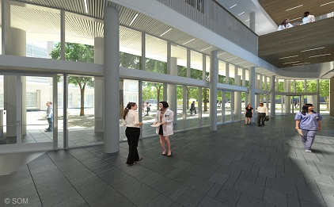
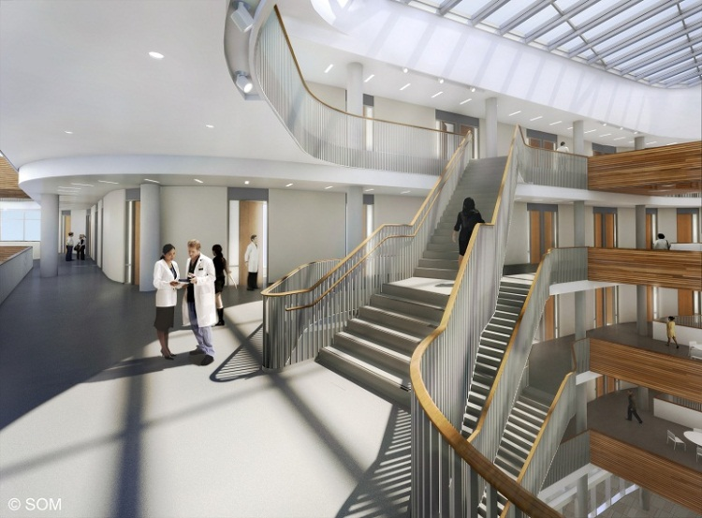
Neurosciences Building, Mission Bay Campus, UC San Francisco
Notes:
Dave

Slide 23
Ground Lease-Leaseback with Tax Exempt Financing
Notes:
Dave

Slide 24
Ground Lease-Leaseback with Tax Exempt Financing
Most applicable to “Commercial” Projects
UC may have first rights of offer/refusal & possibly options but developer must bear risk in transaction
Set price/rent early based on Performance Specifications --or-- Compete fees, UC at risk for pricing & rent resulting from subcontractor bids.
Potentially costly carrying cost for developer financing and equity until option exercised unless tax exempt financing employed.
Notes:
Dave

Slide 25
Neurosciences Building, Mission Bay Campus, UC San Francisco
Project Type: A major research building with laboratories, vivarium, and clinical spaces.
Project Goals: Ground lease leaseback approach was chosen in order to reduce delivery and operating cost.
Land Area: The building footprint comprises approximately 35,000 SF on Block 19A.
Configuration & Use: 6-story research building including full build out of user-specified tenant improvements. UC responsible for developing on-site utilities, equipment, furnishings and landscaping.
Completion Date: Completed Summer 2012
Notes:
Dave

Slide 26
Neurosciences Building, Mission Bay Campus, UC San Francisco
Financing: Hybrid tax exempt finance available through a nonprofit and a conduit issuer based on the University’s use and eventual ownership. University at risk for cumulative design costs in the event final Regental approval was not obtained or the financing could not be consummated.
Comparator: The essential trade off for this project was giving up control in order to reduce risk and manage user expectations through the design process. Despite the tax exempt financing facility, the front end capitalized interest was substantially higher than in UC’s conventional approach and the long term interest rate diluted the University’s underlying credit on the order of 30 basis points.
Notes:
Dave
Scott asks question: How did the University handle the governance structure (and relinquishment of power needed to allow this project to succeed)?

Slide 27
Mt. Zion Medical Office Building UCSF Campus
Notes:
Dave

Slide 28
DEVELOPER BUILD-TO-SUIT
Most applicable to “Commercial” Projects.
Analogous to Design-Build Delivery.
Good technique for Privatized Development on Private Land.
Possible on UC land but challenging solicitation process/requirements in public contract code.
Notes:
Dave

Slide 29
DEVELOPER BUILD-TO-SUIT
Notes:
Dave

Slide 30
Mt. Zion Medical Office Building, UC San Francisco
Project Type: A medical office building on private land proximate to UCSF’s Mt. Zion Hospital.
Project Goals: Developer turnkey for conventional delivery at competitive rate on private land. Developer responsible for securing and entitling the site, as well as for the design, financing and construction of the facility for a fixed price.
Land Area: 13,750 GSF at the NW Corner of Divisadero and Sutter Streets, San Francisco.
Configuration: Medical office building of approximately 49,000 rentable square feet over a multilevel 150 space subterranean garage.
Use: Clinical space and physicians offices.
Notes:
Dave

Slide 31
Mt. Zion Medical Office Building, UC San Francisco
Completion Date: circa 1995.
Lender(s): Taxable construction debt obtained by developer
Analysis: Price included entitled land for the development. Savings in the overall cost were achieved by allowing the developer to use commercial specifications; the building systems are not as robust as comparable UC-developed facility. This project was solicited via an open competition as UC did not have land on which to develop the facilities.
Notes:
Dave
Christine asks question: What benefits does this have over typical University design build delivery to offset the likely higher financing costs and doesn’t it still count against UC debt capacity?

Slide 32
Merced 2020 Project – Concession Agreement
Notes:
Christine

Slide 33
Merced 2020 Project – Concession Agreement
The 2020 Project is an ambitious initiative to develop and finance the next phase of capital projects at the University of California, Merced.
A 21st Century Research University for 10,000 Students
The 2020 Project will provide significant amounts of new teaching and research facilities, housing, athletics and support space for UC Merced.
The ultimate result will be a vibrant, collaborative and sustainable campus for 10,000 students.
Notes:
Christine
Provide question for Dave to ask you…

Slide 34
Energy Biosciences Institute
BP is the largest producer of oil and natural gas in the U.S.
EBI is a partnership between UC Berkeley and BP for the development of sustainable, economically viable, and environmentally friendly energy sources.
BP wanted to explore the use of biology and biotechnology. Specifically, they wanted to develop bioenergy from cellulosic fuels (non-edible plants) and fossil fuel microbiology. But, BP but had no expertise in the biosciences, and knew they couldn’t build the expertise in a corporate lab.
In 2006, BP invited an international competition, looking for:
expertise in bioscience
access to the broader biotech ecosystem
competencies to undertake inter-disciplinary work (agriculture, economics, agronomy, etc.)
world-class talent
the ability to do research on the premises
ability to minimize the effective cost of delivery, taking into account lab costs, overhead, etc.
UC Berkeley was looking for funding; declining government sources
Public-private partnership in this context is consistent with the mission to translate basic, academic research, and allows translation to happen in an expedited manner
Notes:
Rowena

Slide 35
Energy Biosciences Institute
In 2007, UC Berkeley was selected among 46 applicants.
The agreement:
Term of 10 years
$500 million, with $350 million (or $35 million/year) for public institutions
Includes both an open research component, and a proprietary research component.
UC Berkeley is the host institution, but has subcontracts with Lawrence Berkeley National Laboratory and University of Illinois at Urbana Champaign; complementary research
EBI is located in a dedicated building on the Berkeley campus; BP is collocated
Similar to typical sponsored research agreement:
UCB conducts basic academic research
UCB can publish results; owns IP that BP licenses
NERF or exclusive at pre-negotiated, capped fees; UCB is reimbursed for patent costs
To date, BP has always chosen an exclusive license
Unique:
Proprietary research component
Conducted in leased space, by BP employees; results are confidential and owned by BP
EBI funds faculty positions
Not specific pre-defined research project; grant awarding
BP is hands off on what projects are funded
First time that UC Berkeley has rented space to industry (at FMV)
Industry-sponsored research increasing
Notes:
Rowena
Provide question for Scott to ask you

Slide 36
Laboratory Joint Venture - China
Historically, Chinese medicine focused on treatment, rather diagnosis. Consistent with that history, there are few pathologists in China.
But with the increase in a more-informed middle class, the focus is shifting to diagnosis.
CTI is a publicly traded company that provides product testing, inspection and certification for consumer products. CTI wanted to establish a lab in Shanghai, and sought a U.S. academic partner to run the lab.
In 2014, UCLA Health System and Centre Testing International (CTI) entered into a joint venture to form a company that will operate a lab in Shanghai.
Notes:
Rowena

Slide 37
Laboratory Joint Venture - China
The UCLA/CTI joint venture is the first partnership between a Chinese company and a U.S. academic medical center to create a specialized lab in China.
The lab will offer genetic and molecular diagnostics and other sophisticated tests.
The lab will enhance medical care for Chinese patients by allowing physicians to accurately diagnose and treat patients.
Terms:
CTI will provide capital funding and marketing expertise.
UCLA will train Chinese lab specialists, provide test procedures and protocols, and oversee management of the lab to ensure compliance with international quality standards.
The joint venture furthers UCLA’s mission of improving the health of people and communities worldwide through education, research and service.
Notes:
Rowena
Provide question for Christine to ask you

Slide 38
New Opportunities for Infrastructure PPPs
Growth Areas – Beyond Transportation
Social Infrastructure
Water
Wastewater Treatment and Reclamation
Energy
Waste to Energy
Data Centers
Notes:
Scott

Slide 39
Balancing the Many Priorities of Public Service
Public
Oversight
User/Customer
Satisfaction
Cost/Rate
Mitigation
Social and
Environmental
Responsibility
Owner Finances
OpEx + CapEx
System
Reliability
Notes:
Scott

Slide 40
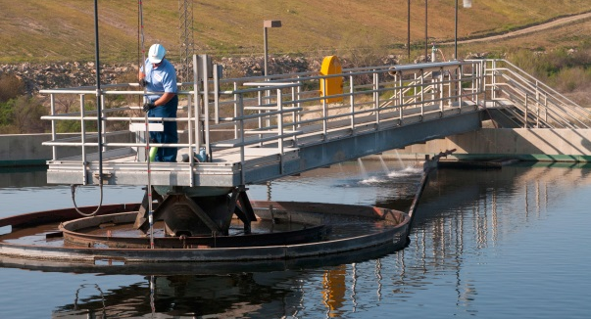
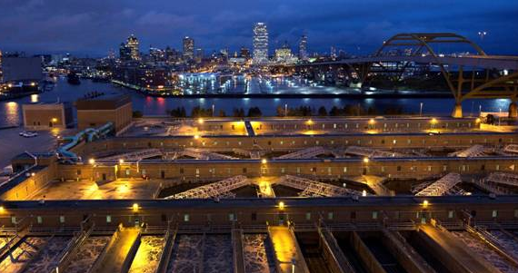
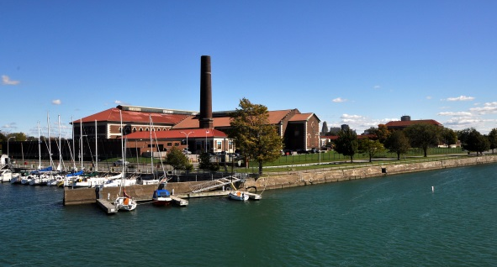
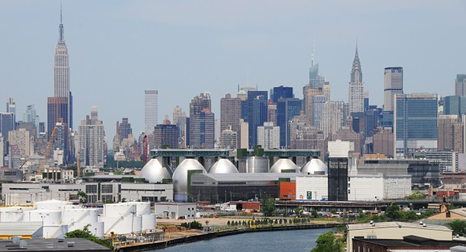
Spectrum of Risk Sharing
Concession | O&M | Delegated Mgmt. | PPS Consulting
Injection of cash | Operating costs reduced | Performance-focus for management | Advisory services to help save costs
High risk transfer to concessionaire | Partial risk transfer to operator | Small risk transfer to contractor | No risk transfer to consultant
High speed of improvement | High speed of improvement | Med/slow speed of improvement | Medium speed of improvement
Procurement: Complex | Procurement: Slightly challenging | Procurement: Easy | Procurement: Very easy and quick
Rialto, Calif.
Milwaukee
Buffalo
New York City
$35 MILLION IN CASH TO THE CITY OF RIALTO (PLUS $41M IN CAPITAL FINANCE)
$35 MILLION IN SAVINGS TO THE CITY OF MILWAUKEE
$1 MILLION IN ANNUAL SAVINGS TO THE CITY AND IMPROVED PERFORMANCE
$23 MILLION IN ANNUAL SAVINGS IMPLEMENTED TO DATE FOR NYC
40
Notes:
Scott
40

Slide 41
Case Study: Arvin, California
Design Build Finance Operate Maintain Contract 2.5 MGD Treatment Plant and 27 Miles of collection systems
California Gov. Code Section 5956.1: Procured through a competitive solicitation
IRS qualified agreement: Intended to comply with Treasury Regulations and Private Activity Limitations (Rev. Proc. 97-13)
$6M in Construction Financing
Flexibility: Designed to accommodate changes in scope, law and municipal financing
Guaranteed Performance
35 Year Term
Notes:
Scott
Provide question for Dave to ask you

Slide 42
Case Study: Rialto, California Concession
30-year partnership committed to the performance, safety, customer and community satisfaction
$35M in upfront to the city for development investment, reserve
$41M in funding for water and wastewater system improvements and associated jobs
$2M annual utility lease payments to the city
All existing city employees have remained employed
445 construction jobs generated from new projects
“The partnership ensures that the city's water and wastewater infrastructure is upgraded and run in the most cost-efficient manner, while also laying the groundwork for new economic development.”
Mike Story , Rialto City Administrator
Notes:
Scott

Slide 43
Higher Ed - Concession Structure
Fiat Lux University
System Owner
System Lease
Lease Payments
Equity + Debt
Under private equity model
Campus Ratepayers
Programmatic Facilities
Medical
Housing
Auxiliary Enterprises
OR
Capital $
New Utility
Concessionaire
$ Payments
100% debt
Under quasi-public model
Services
Facilities
Operations and Maintenance Agreement
OpEx
Funding $
CapEx
Funding $
Operations
Infrastructure
Notes:
Scott
Provide question for Rowena to ask you

Slide 44
Infrastructure Projects -- Goal to Eliminate Waste by Reducing
Output variability
Overstaffing
Interference
Improper Management
Insufficient work to Perform, Equipment
Weather delays or Design Error
Rework
Material Shortages
Inspection/Wait/Reinspection
Labor Shortage and Inadequate Training
Notes:
Dave

Slide 45
Infrastructure Projects – PPP Goals Eliminate Waste/Reduce Cost/Manage Risk
Reduce Life Cycle Cost inefficiencies
Bundle maintenance cost/construction costs
Incentivize efficiency
Present Value of Revenue (PVR)
Manage (not transfer) Risk
Choose Appropriate contract mechanisms
Transparency (budget, construction and maintenance)
Prevent “renegotiation” scenarios
Implement Best Practices and Business Case Analyses
Notes:
Dave

Slide 46
Critical Issues for UC
Key Financial Points
Many projects still on UC balance sheet
Bonding vs Personal Guarantees
Credit Crisis Impact on Developers and Financing
Key Process Points
How to handle unsolicited proposals
How to ensure competition
How to ensure transparency
Notes:
Dave

Slide 47
Enabling Legislation
Notes:
Christine

Slide 48
University Partial Ownership Exception
Public Contract Code Section 10505
The Construction Competitive Bidding statute “shall not be applicable to (1) any project of which the Regents of the University of California is only “part owner’.”
Notes:
Christine

Slide 49
California Government Code Section 5956 Infrastructure Financing Act
Fee Producing Infrastructure Facilities
Includes design, finance, construction, repair, operation and maintenance -- all funded by private investment capital
Facility must be paid for by persons/entities benefitted
Contracts and/or leases allowed
Competitive negotiation process based on “demonstrated competence and qualifications,” but not “competitive bidding
Private ownership up to 35 years with no cost reversion (AMENDMENTS PENDING)
Notes:
Christine

Slide 50
California Government Code Section 5956 Infrastructure Financing Act cont.
Hearing required for increase in user fee
Combination of local government agencies may work cooperatively
Not allowed for:
- toll roads on state highways
- state water projects
- state park and rec projects
- state financed projects
Notes:
Christine

Slide 51
California Government Code Section 5956 Infrastructure Financing Act
Allowed for:
Irrigation, drainage, energy/power production, water supply treatment and or distribution, flood control, inland waterways, harbors, municipal improvements, commuter and light rail, highways and bridges, tunnels, airports and runways, water purification, sewage treatment refuse disposal
Structures and buildings except for structures or buildings that are to be used primarily for sporting or entertainment events
Notes:
Christine

Slide 52
California Government Code Section 4217 (Energy Conservation Act)
Energy Conservation, Cogeneration and Alternate Energy Supply Sources
Award based on “best interests of public entity” for conservation and cogeneration contracts
Rates for sale of electricity, generating capacity or thermal energy on terms approved by governing body
RFP process required
Great latitude allowed
Notes:
Christine

Slide 53
Florida – House Bill 85
In June 2013, Florida Gov. Rick Scott signed into law House Bill 85, which authorizes municipalities, counties, school boards and other political subdivisions of the state to use PPPs to develop a wide range of facilities, including schools, public buildings, ferries, mass transit facilities, parking facilities, port facilities, power generation facilities, oil or gas pipelines, medical or nursing care facilities, water/wastewater facilities, recreation facilities and more.
Prior to 2013, Florida employed P3s for state transportation projects only.
HB 85 also established a Partnership for Public Facilities and Infrastructure Act Guidelines Task Force charged with researching and recommending a uniform process that public authorities can use to establish P3s, including project selection and review procedures.
Notes:
Christine

Slide 54
North Carolina – House Bill 857
North Carolina is a less mature but expanding market for P3s.
Historically in North Carolina, local municipalities and state agencies required approval from the State Building Commission to engage in any type of procurement for construction other than traditional procurement methods.
In August 2013, Governor Pat McCrory signed into law HB 857, which empowers these entities to engage in alternative delivery methods.
Although unsolicited proposals are not contemplated under the statute, public entities may still pursue alternative procurement vehicles subject to the stringent criteria set forth in the new statutory framework.
Notes:
Christine

Slide 55
Maryland
Maryland is showing solid interest in joining the P3 movement with its enhanced P3 law that took effect in July 2013.
Extending beyond transportation projects, the law offers a mechanism that balances the need to incentivize private sector investment with the need for oversight and transparency.
While the P3 law does not specifically address the use of P3s by Maryland counties and cities, localities are not prohibited from pursuing P3s or passing local laws to encourage the use of P3s.
Notes:
Christine

Slide 56
Pennsylvania – House Bill 1838
Governor Tom Corbett signed the P3 Law in July 2012 which allows state and local public entities to enter into P3s for the design, construction, operation, maintenance, financing, or leasing of transportation facilities, and limits the term lengths to 99 years.
Similar to the 2012 legislation that established guidelines for the use of P3s in transportation projects, a House Bill (HB 1838) sponsored by State Rep. Eli Evankovich (R-Westmoreland/Armstrong) aims to provide P3 opportunities to local governments, school districts, counties and municipal authorities for the construction of water and sewage projects, school buildings and other public facilities. Before the Bill can be voted on by the House of Representatives, it must be considered and approved by the House State Government Committee. Although, we understand HB 1838 may go forward only for water and sewer projects with municipal buildings to follow.
Notes:
Christine

Slide 57
New York and New Jersey
New York Senator Ball and Assemblyman Schimminger have partnered on bipartisan proposed P3 Legislation, S5501, by authorizing private entities to design, build, finance, operate, and maintain public infrastructure assets
In April 2013, the Port Authority of New York & New Jersey authorized a $1.5 billion P3 award to NYNJ Link Partnership to provide the design, build, finance, and maintenance for a replacement to the 80-plus-year-old Goethals Bridge
New Jersey Economic Development Authority- The Higher Education Institution Public-Private Partnerships Program permits a state or county college to enter into a private-public partnership and allows a private entity to assume full financial and administrative responsibility for an on-campus construction, reconstruction, repair, alteration, improvement or extension of a building, structure, or facility of the institution so long as the college retains ownership of the land, and the project is 100% privately financed.
Notes:
Christine

Slide 58
Questions?
Scott Abrams, Senior Counsel, West Municipal & Commercial Business Veolia North America
Email: scott.abrams@veolia.com
David Bergquist, Chief Campus Counsel, University of California, Riverside
Email: david.bergquist@ucr.edu
Christine Haas Georgiev, Senior Counsel, Real Estate & Construction University of California, San Francisco
Email: christine.haasgeorgiev@ucsf.edu
Rowena Manlapaz, Senior Counsel, University of California, Office of the General Counsel
Email: rowena.manlapaz@ucop.edu
Notes:
Remember to address any issues that NACUA has requested we address…

